Slide 1


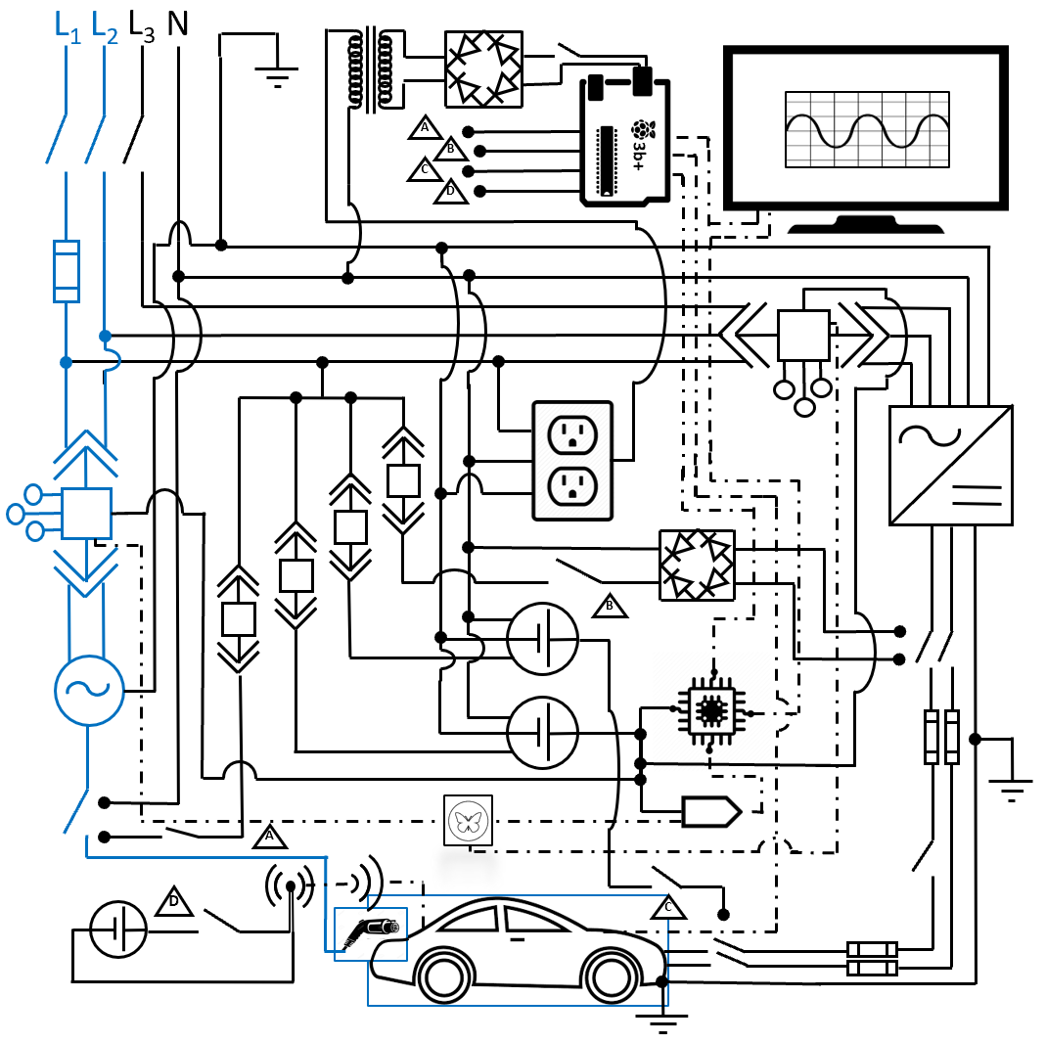
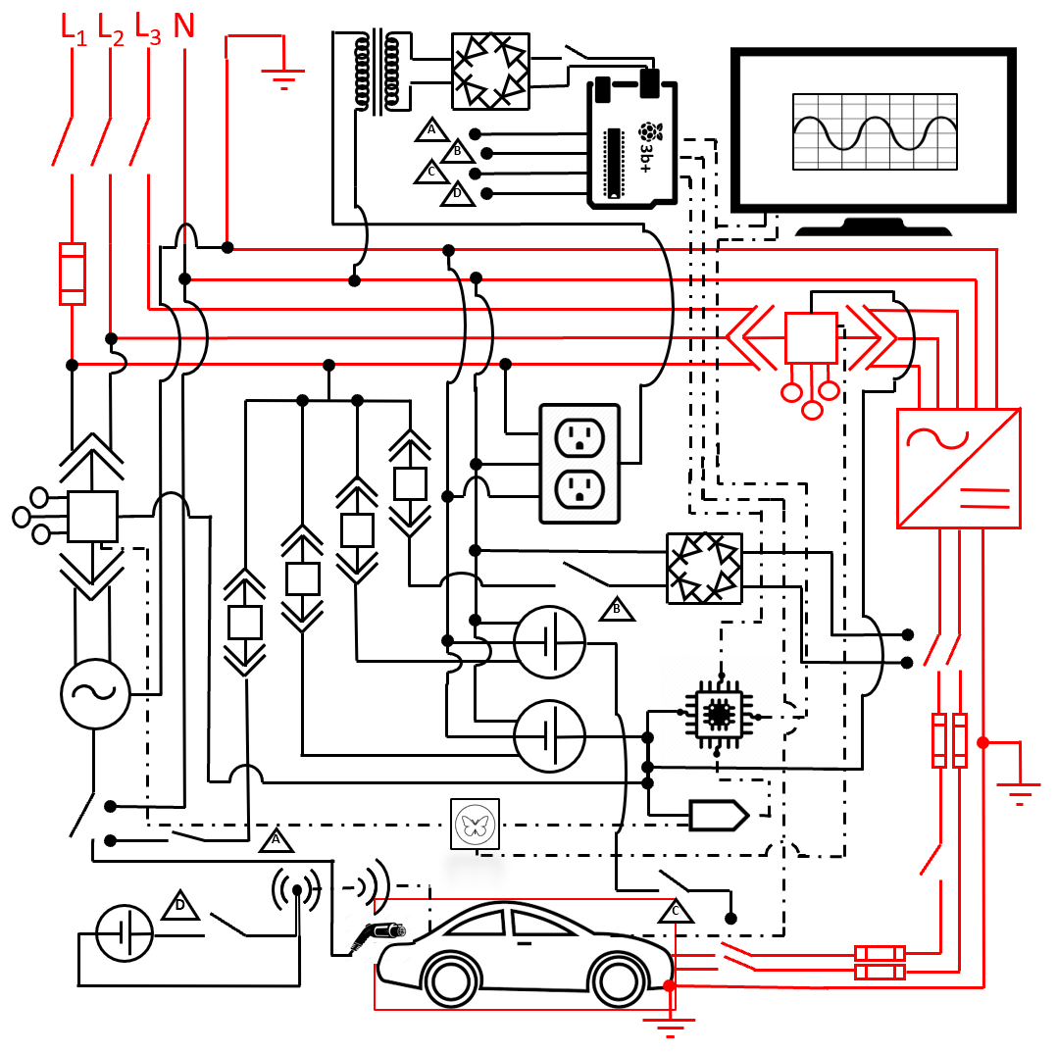
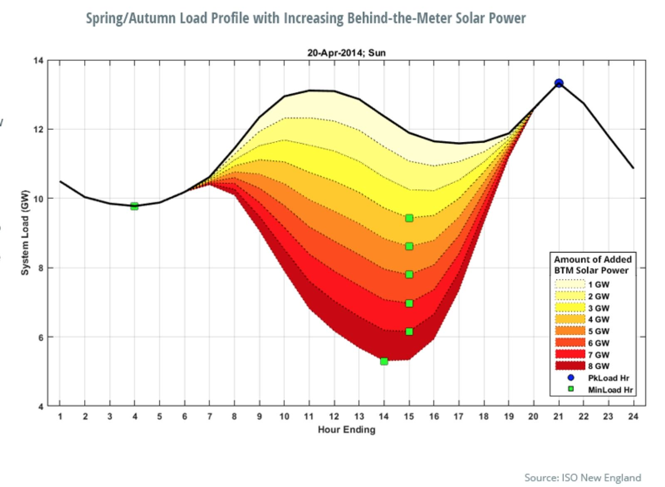
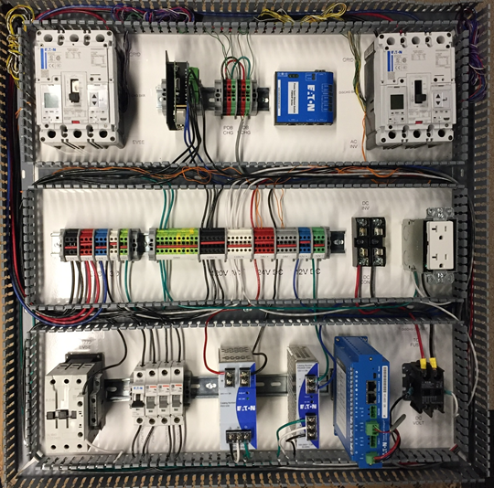
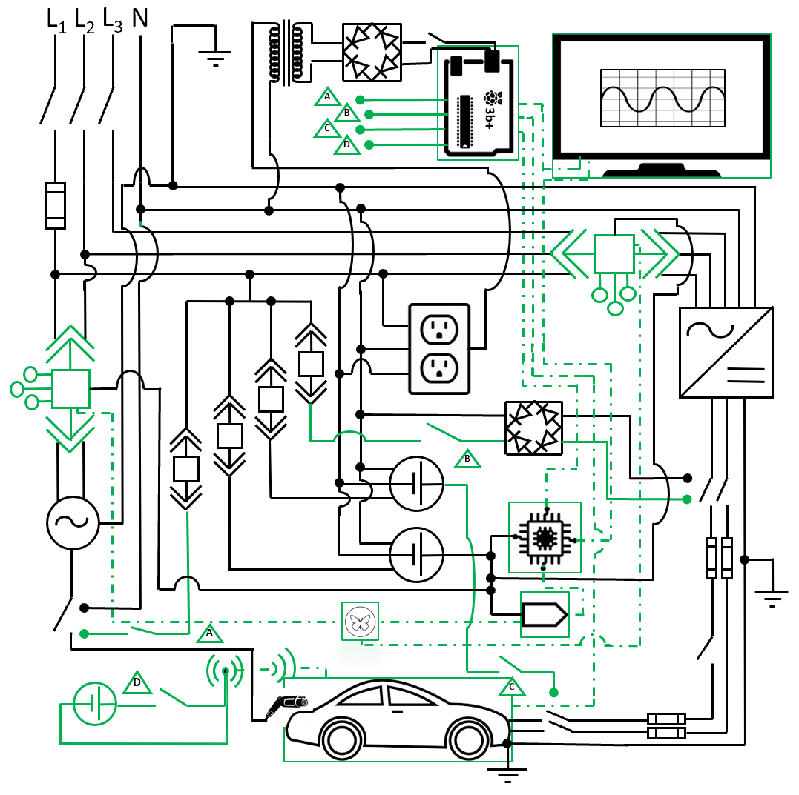
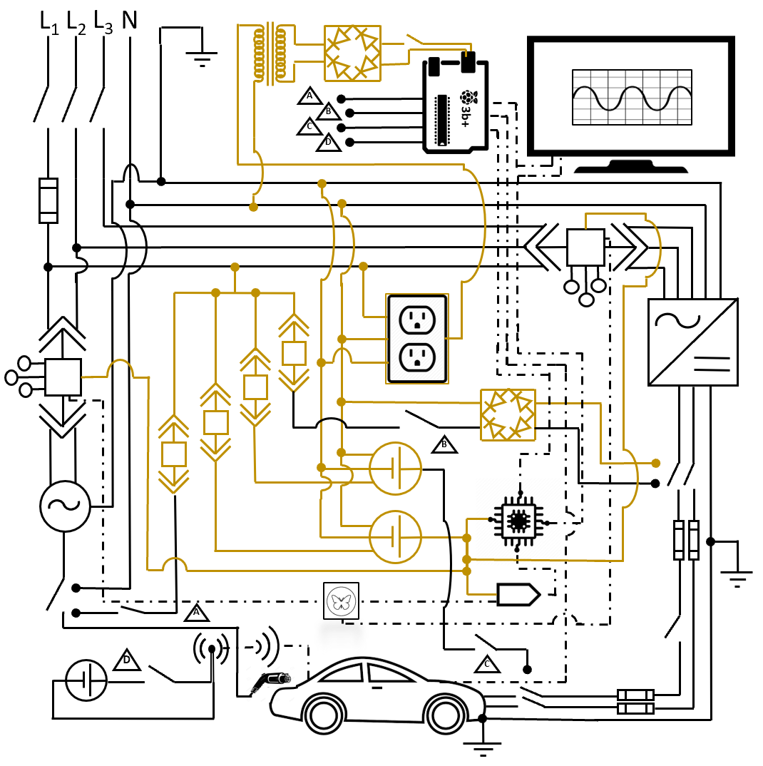
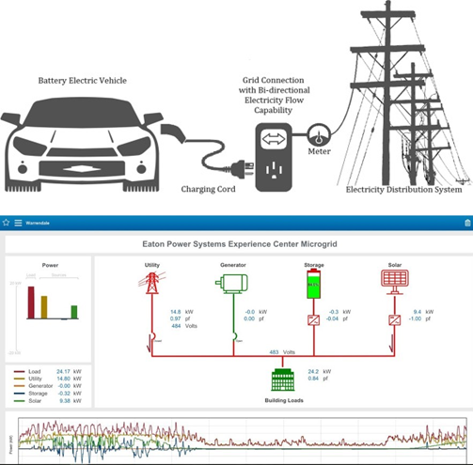
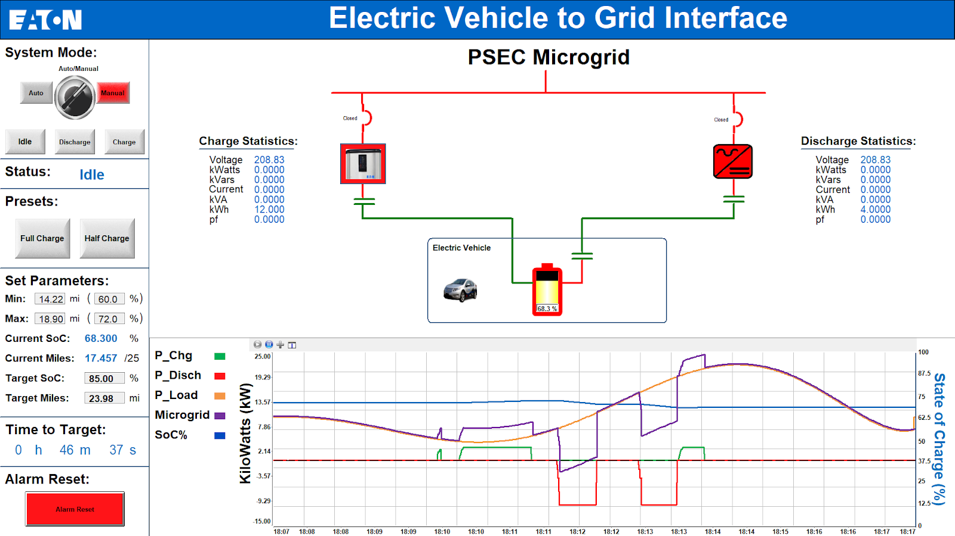
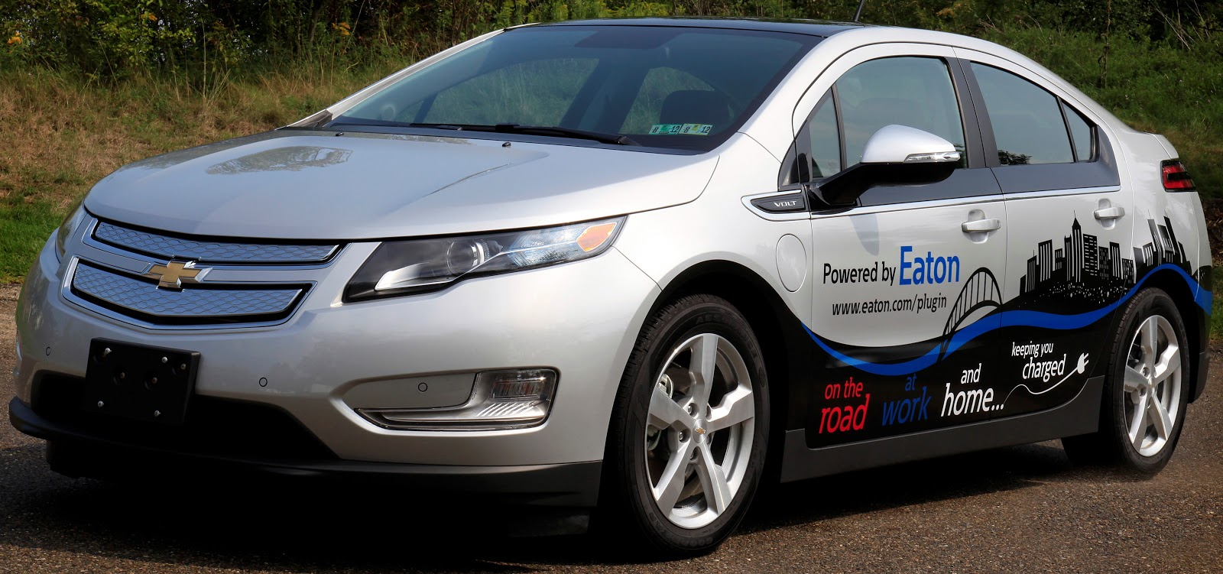
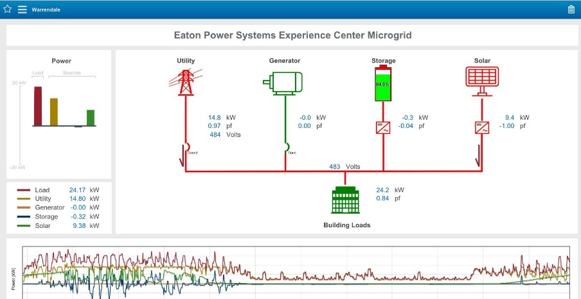

Electric Vehicle to Grid: Microgrid Integration
Industry Impact
System Schematic Breakdown
Realization & Testing
With an ever-aging infrastructure, the nation’s power grid continues to face growing challenges in stability and efficiency. This problem is
Charge Path
Discharge Path
After construction, the system was characterized in full via looped charge and discharge between PSEC’s microgrid and the 2011 Chevrolet Volt.
exacerbated with the rise of intermittent renewable energy sources like solar and wind., which cause further ssssssssssssssss
fluctuations in the energy generation and consumption throughout the day.
------
Vehicle to Grid (V2G) is an emerging technology in the power systems field. The V2G paradigm sees electric vehicles as potential mobile energy storage units – the high capacity batteries can be charged when grid demand is low and also discharged back to the grid during periods of high demand.
Controls and Network
Auxiliary Circuitry
Speed (Constant Rates):
a. Full charge: 6hr @ 3kW
b. Full Discharge: 1.8hr @ 10kW
c. Charge-Discharge cycle: 90s
d. Discharge-Charge cycle: 15s
Accuracy (Error%)
a. Charge to target: < 1%
b. Discharge to target: < 1%
c. Metered Data: < 1%
d. Estimated time: < 5%
Safety: all contactors open upon communication error
This selective power flow can help balance generation and demand, thereby 1. increasing efficiency, 2. reducing system strain, and 3. decreasing the risk of failure and black outs.
Operator Interface
Future Plans
The system will become a permanent installation at PSEC (Warrendale, PA) for demonstration. Continual improvement is planned to implement true bidirectional charging, compacting, and integration with PSEC’s system-level microgrid controller.
Design Space
A 2011 Chevrolet Volt (hybrid) was provided by Eaton to interface with PSEC’s microgrid, a utility-tied network of generation sources and consumption loads built for system-level power flow analysis.
Acknowledgements
We are extremely grateful to Eaton for funding the project and would like to extend personal thanks to Erik Hurd, Amit Gholam, Santino Graziani, Brandon Grainger, and Dan Carnovale for their exceptional guidance, support, and enthusiasm.
The user interface was developed in Eaton’s Visual Designer software in order to provide a convenient way to control the system and analyze grid power flow during professional system demonstrations.
Notes:
Dr. Modo

Slide 2
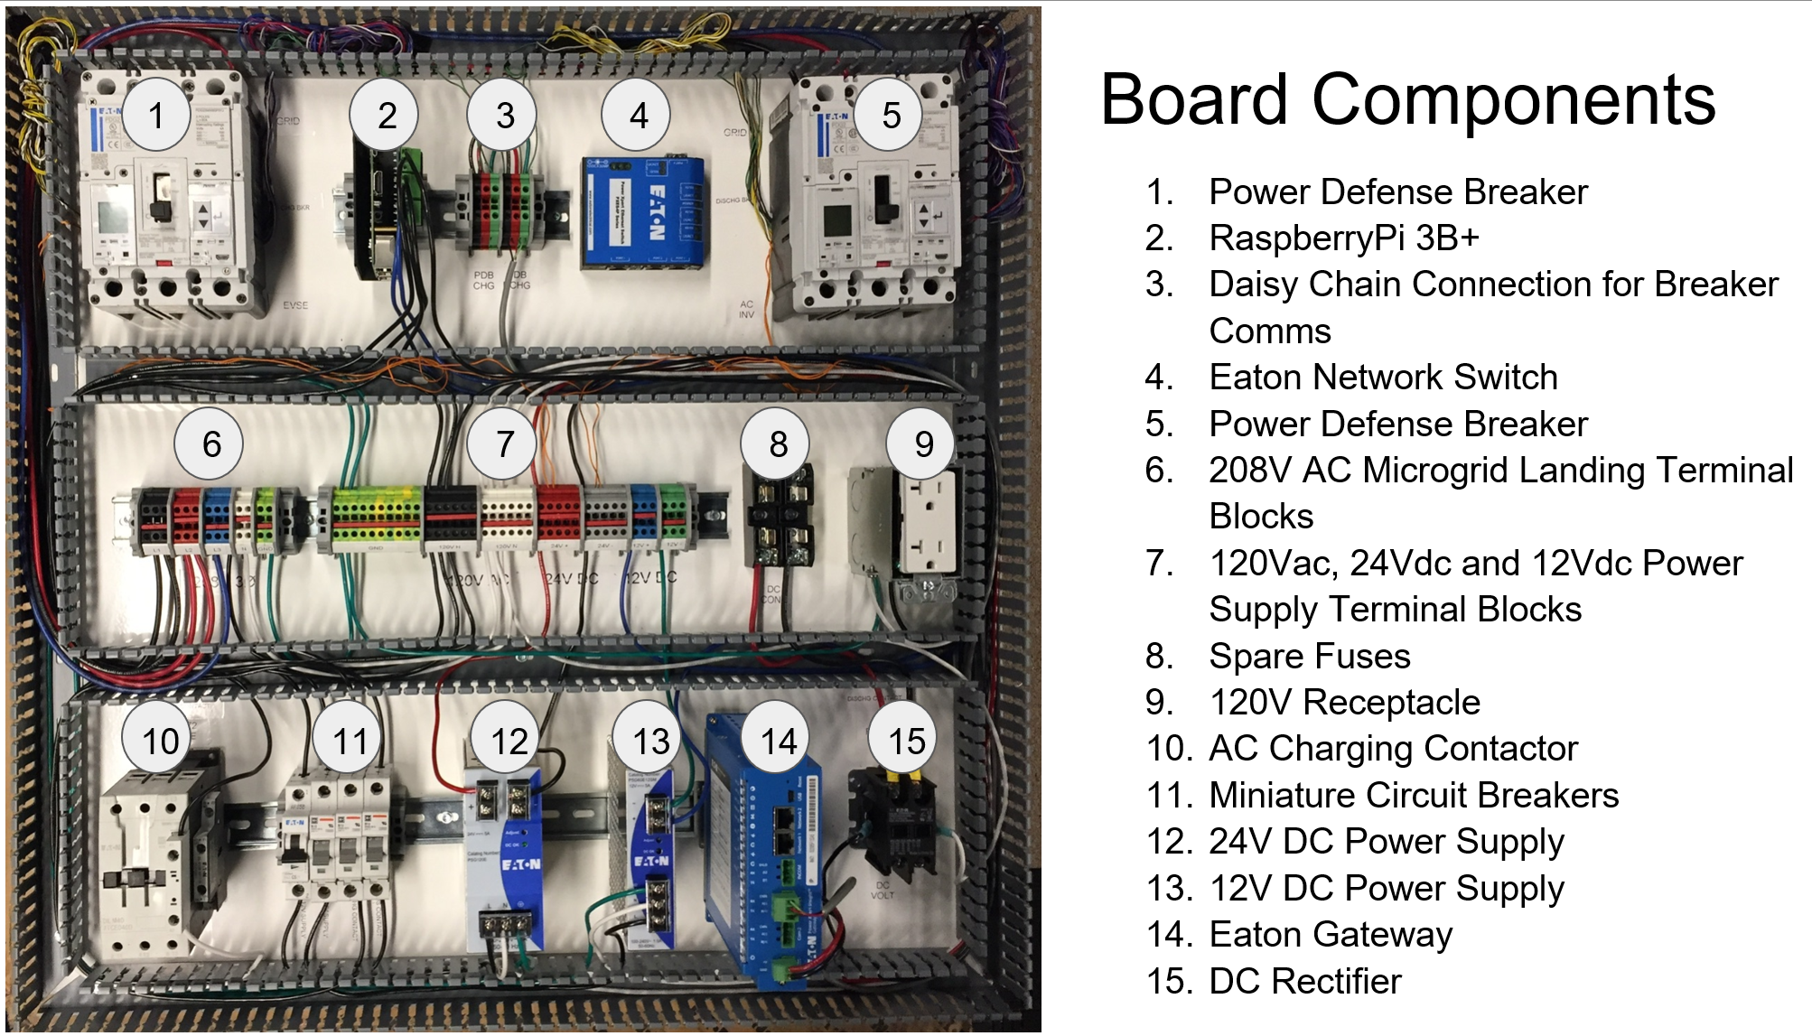

Slide 3
